Slide 1
Introduction to Computer Hardware

Slide 2
PC form factors Computer parts
What you need for a computer build
●
●
●

Slide 3
So what is a computer?

Slide 4

Typically associated with the “electronic box” we know and use today. Originally developed as a calculator as a way of more efficiently solving mathematical calculations.
●
●
The idea of the modern computer is generally attributed to Alan Turing who hypothesised a device known as a Turing Machine; a device capable of performing any task as long as it could be represented as an algorithm (e.g. 2+2).
Technically any device capable of solving mathematical problems is a computer (as it is computing something).
●

Slide 5
A chassis
Computers come in a wide variety of styles, form factors and purposes. In general the common features of what we would call a computer include:
●
Case
All-in-one
Input devices
●
System parts
●
– Mouse and keyboard Touch screen
– CPU
Motherboard Etc.
–
–
Output devices
–
●
Display
Speakers

Slide 6
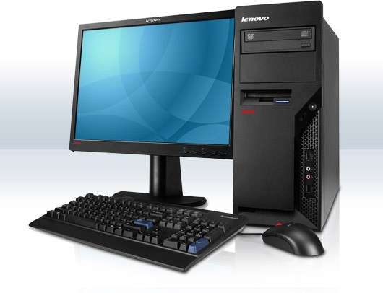
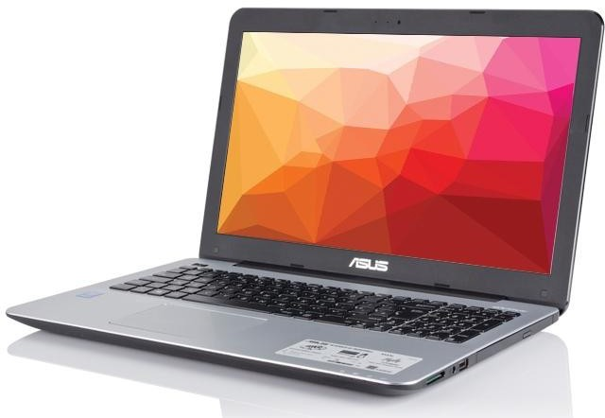
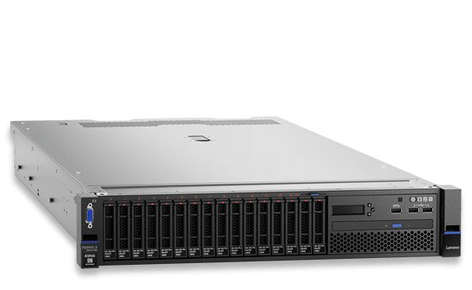
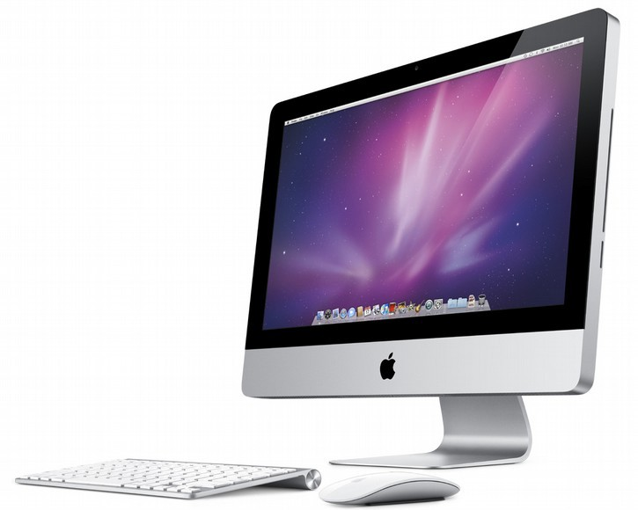
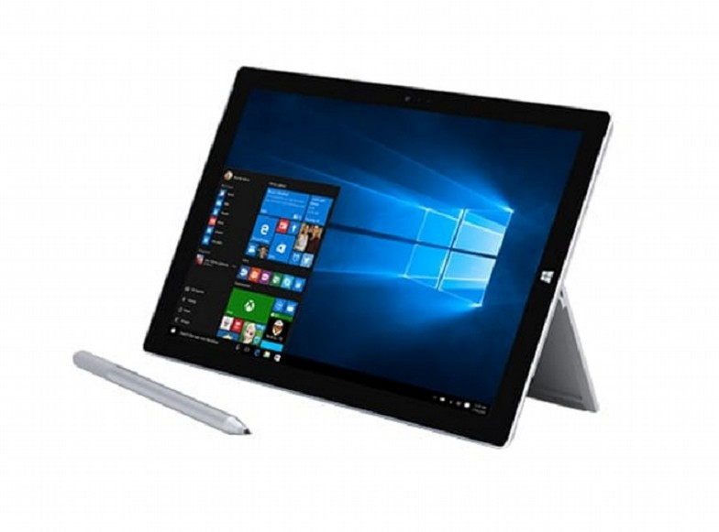
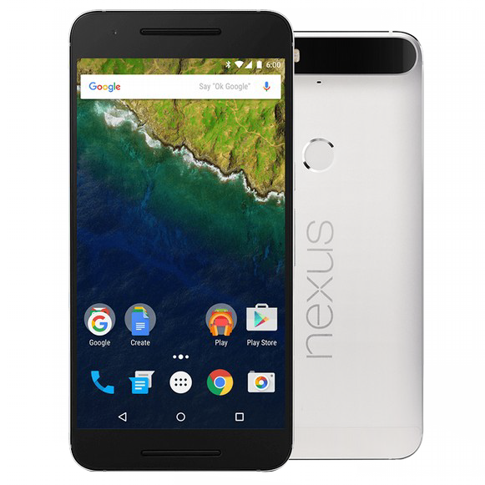
Form Factors
Desktop PC
Notebook
Rack-mount Server
All-in-one PC
Smartphone

Slide 7
Computer System
●
For this class we will be focussing on a Desktop PC style computer.
In this type, most of the hardware is contained within the case.
Usually an issue with a PC will be a problem with the hardware in the case or the cables connecting it to the rest of the hardware peripherals.
●
●

Slide 8
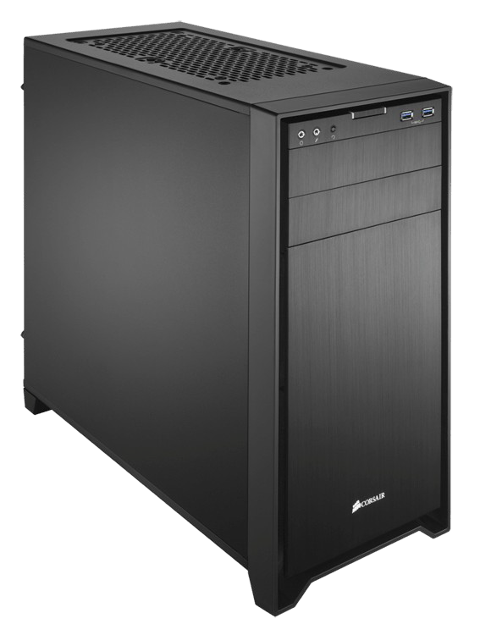
Chassis / Case
●
The chassis or case is where all of the hardware components get mounted.
Provides protection, cable management and airflow control.
Comes in many, many styles, sizes and shapes for different uses.
Must be chosen to fit the size of motherboard used.
●
●
●

Slide 9
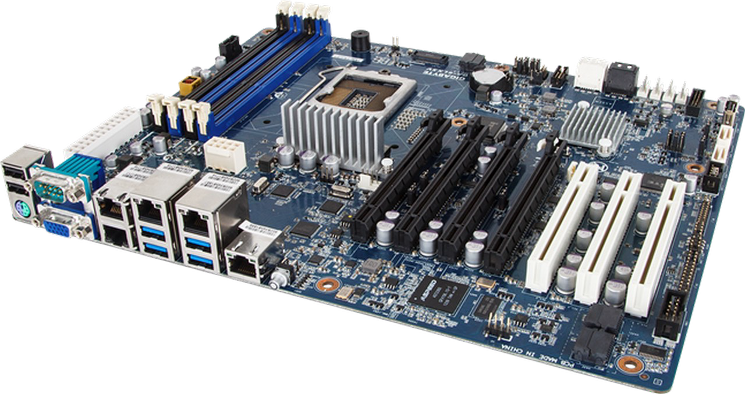
Motherboard
●
The motherboard is the main hardware component in a computer system.
It defines what hardware components can be used (e.g. CPU, RAM)
Comes in a variety of standard sizes to fit different needs.
●
●

Slide 10
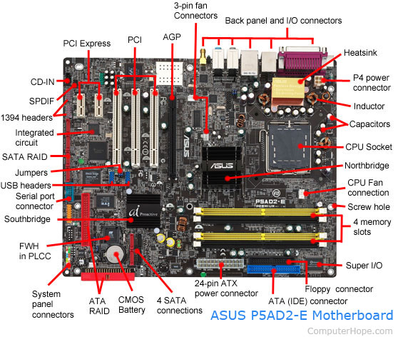

Slide 11
Motherboard
●
Different sizes include:
– ATX (“the standard”) EATX (large footprint) mATX (small footprint)
mITX (really small footprint)
–
–
–
Provides ports and slots to allow for hardware to be added. Largest single part and so the largest single point of failure.
●
●

Slide 12
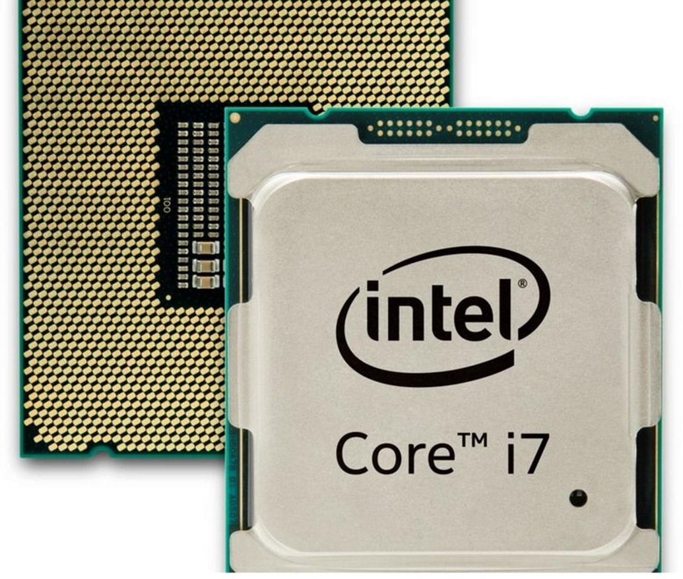
CPU
●
CPU stands for “Central Processing Unit”
The “brain” on the computer
The two main manufacturers of consumer PC CPUs are Intel and AMD
Generates a lot of heat so must be kept cool with a heatsink
●
●
●

Slide 13
CPU
●
Identifying characteristics of a CPU include:
– Clock speed – The clock speed measures the number of cycles your CPU executes per second. The speed that the CPU “ticks”; usually measured in gigahertz (GHz)
Number of cores – The physical processor cores inside the CPU. Many modern CPUs come in dual-core or quad-core
Socket type – The physical footprint the CPU fits into on a motherboard. For example; the LGA1151 socket (Intel) or the FM2+ socket (AMD).
–
–

Slide 14
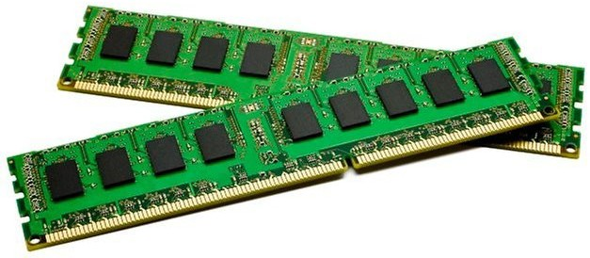
RAM
●
RAM stands for “Random Access Memory”
Referred to as random as any (random) memory location can be read from or written to at roughly the same speed
Volatile storage; i.e. data is lost when power is removed
Most commonly found as DDR
(Double Data Rate)
●
●
●

Slide 15
RAM
Used for temporary storage of data and running applications Data is loaded into RAM before and after it is needed by the CPU Identified by:
●
●
●
– DDR number – DDR2, DDR3 & DDR4 are all types of RAM. Correct DDR number must be chosen as they are not physically compatible i.e. a motherboard that requires DDR3 RAM can only use DDR3.
Capacity – RAM modules have a data capacity; usually measured in gigabytes (GB).
Frequency – RAM operates at a frequency (similar to CPU clock) and some motherboards only support certain frequencies.
–
–

Slide 16
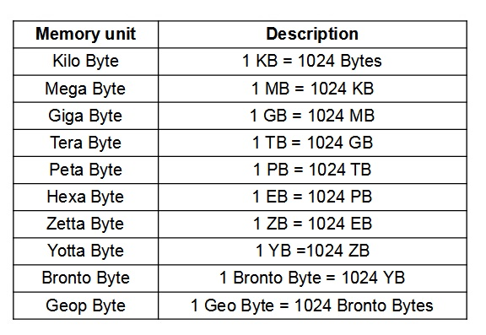

Slide 17
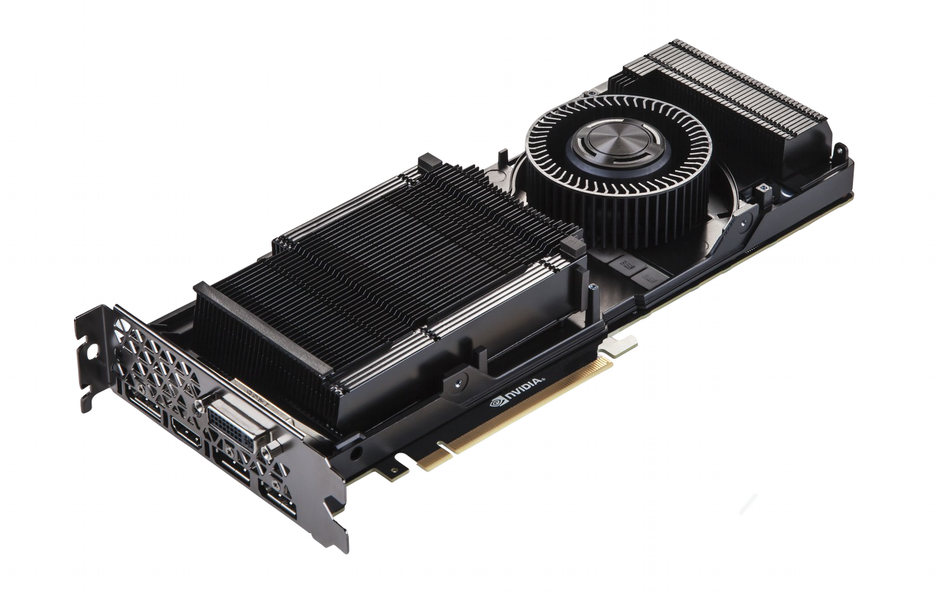
Expansion Card
●
Expansion Cards are used to provide additional functionality to a PC
Motherboards generally provide one or more slots to add expansion cards to
The three most common slots are:
●
●
– PCI
PCIe (PCI Express) PCIe x16
–
–

Slide 18
Expansion Cards
PCI stands for Peripheral Component Interconnect
PCI is being phased out in favour of PCIe and PCIe x16 which are both faster and can provide more power
Some expansion cards include:
●
●
●
– Graphics cards Audio cards
Network cards (Ethernet and Wireless) SSDs (Solid State Drives)
–
–
–

Slide 19
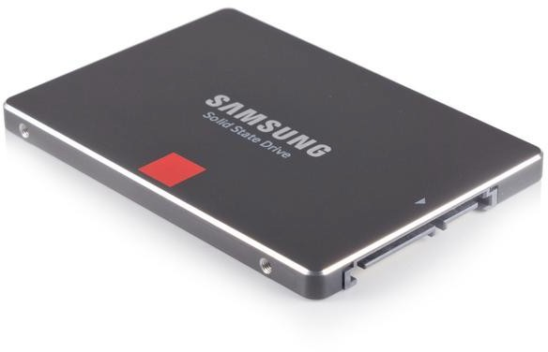
Storage
●
Typically storage devices are non- volatile (data is maintained without power)
Come in many capacities and types
Some storage types include:
●
●
– HDD (Hard Disk Drive) SSD (Solid State Drive) Flash (USB “thumb drive”) CD / DVD
–
–
–

Slide 20
Storage
●
“Hard drives” or storage drives in PCs are usually one of two types:
– HDD – Typically a spinning platter type hard drive. Uses a spinning glass or aluminium disk with a magnetic coating. A small arm moves across the surface while it spins to read or write data. Can be damaged if moved abruptly while in operation.
SSD – Solid state memory uses memory chips to store data. Contains no moving parts and uses less power than an HDD. Generally not as high in capacity as HDDs but improving as technology advances.
–
●
SSDs are becoming more commonplace owing to their better performance and prices becoming more competitive ($ per GB) when compared to HDDs.

Slide 21
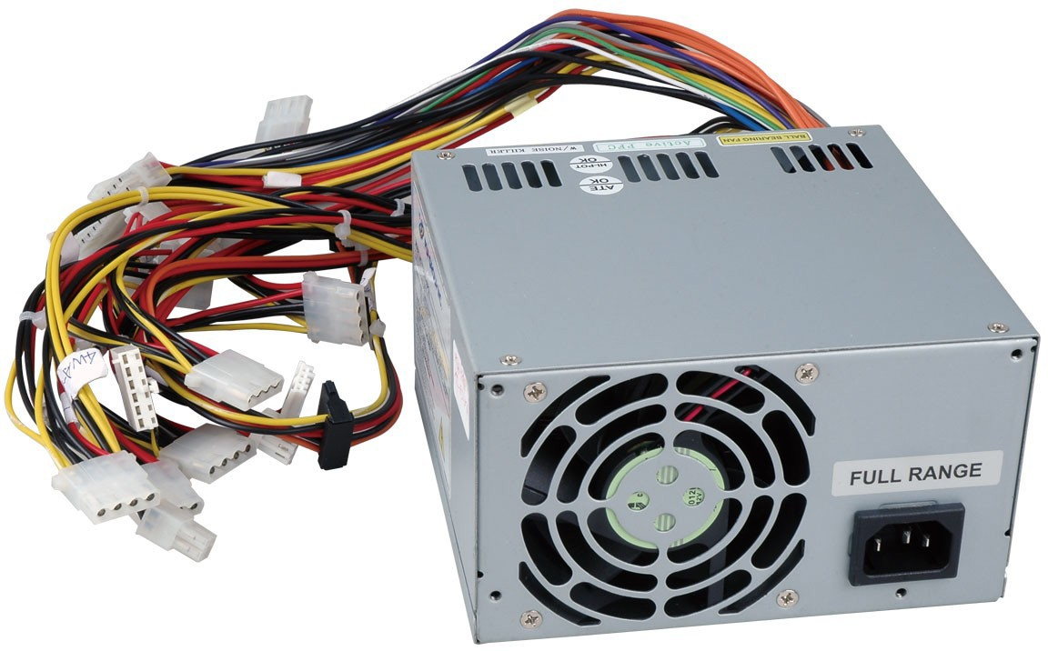
Power Supply
●
Officially known as a “PSU” or Power Supply Unit
Converts mains electricity (240V AC in Australia) to computer friendly levels (12V, 5V and 3.3V DC)
Generally referred to by its power handling capacity (e.g. 500W)
●
●

Slide 22
Power Supply
●
The power handling capacity of a PSU must be chosen based on the components used in the system. As a rough guide:
– 100W for the CPU
50W for the motherboard 5W per RAM module 300W for a graphics card 10W per HDD
5W per cooling fan
–
–
–
–
–
●
Choose a PSU that has around 50% more power capacity than you need.

Slide 23
Power Supply
●
Most power supplies are of an ATX type and have a standard footprint and complement of cables.
Special form factor PCs often have a custom power supply footprint and capacity and cannot be replaced without purchasing a new one from the manufacturer.
DO NOT open a power supply. Dangerous voltages are present inside a PSU even if the power is off and unplugged.
●
●

Slide 24
Putting it all together
●
For a complete tower you will need:
– A CPU
A motherboard
At least one RAM module A case
A PSU
At least one hard drive
–
–
–
–
–

Slide 25
Putting it all together
●
For a “complete” system you will also need:
– One or more monitors A keyboard
A mouse
Cables to connect the various parts
–
–
–

